Slide 1



Open Education Analytics
modern data estate for education

Slide 2

Scenarios You Need
Personalized Learning Pathways
Real Time Data Dashboards
Open Data for Research and Evaluation
Unlock AI for Learning and New Assessment Models
State, Province and National Longitudinal Reporting
Notes:
– If you could do this, however, it could enable many key education scenarios, from personalizing learning pathways; to real time reporting to schools, departments, educators, learners, and parents or guardians; to accelerating research and evaluation on programs and interventions. It could also unlock the power of AI and provide more efficient state and national longitudinal reporting. It all starts with setting up the modern data estate.

Slide 3
Solving the problem…
standards
best practices
rapid iteration/
emergent design
modern tech
ecosystem / global community
data standards (at rest, in transit)
process standards (ethical use, dev cycle, testing)
ethical use
ref architecture, ref implementation
dev process (dev cycle, testing strategy, releases)
training
sandbox env, test data sets
evolve schema
emphasis on build-learn-improve
cloud-based (low cost, infinitely scalable)
easy setup (setup scripts, infrastructure as code)
easy maintenance (auto-scale, monitoring)
easy to extend (extensible arch, add-on modules)
customers, SI’s, ISV’s, standards bodies, policymakers
focus on sharing, collaboration
Notes:
It starts with the edtech ecosystem. We need to collaborate and crowd-source the foundational pieces that allow us as an industry to operate and differentiate at a higher level
The modern tech is a game changer. Everything is far easier and cheaper than it’s ever been, if you’re using the right tools.
Real solutions are built through iterations, not endless design and planning. Rapid iterations allow teams to keep moving forward over time, capturing value today as well as creating more value tomorrow.
Patterns naturally emerge from iterations; leading to common best practices.
Standards are the codification of everything we’ve learned as an industry. Data standards are the pinnacle – they are the answers we’ve derived over time. We can and should use them from the start wherever possible, but shouldn’t expect the data standards to have all the answers we need to begin with. The current state of our edu data standards is not great – we have to derive the answers we need and accelerate the development of those standards.

Slide 4


What is Open Education Analytics
OPEN EDUCATION ANALYTICS TECHNICAL RESOURCES AND COMMUNITY
ROLE AND TECH TRAINING AND CAPACITY-BUILDING ON LEARNING ANALYTICS AND AI
PRINCIPLES OF RESPONSIBLE DATA AND AI APPLIED TO EDUCATION
SHARED LEARNING ANALYTICS AND AI USE CASES IN COMMUNITY
Notes:
We see Open Edu Analytics as a natural next step in customers’ journey to Learning Analytics and AI. And we have many large education system customers who are interested in taking this journey, including state departments of education and national ministries of education around the world.
The great news for partners is that there are many opportunities to participate in this ecosystem, and we are depending upon you to make it scale and grow the assets.
Starting from the thousands of customers adopting SDS and Education Insights, there are many steps in the journey where ISVs, System Integrators, data science and AI companies, and Training providers will be needed to build this Open Education Analytics ecosystem.

Slide 5













Data
Engineers
Data
Scientists
Contracted
Data Scientists
Learners,
Educators
School Leaders,
Researchers
Analysts
Personalized
Learning
Pathways
1) Authentication/Authorization
Azure Active Directory
Realtime Data Dashboards
On-premises data
2) Data Processing Tools
Open Data for
Research and Evaluation
Cloud data
Azure Synapse Analytics
SaaS data
State, Province and National Reporting
3) Storage
Azure Data Lake Storage
1) Collect
2) Compute
3) Communicate
Notes:
The modern data estate enables you to take all this disparate data and give your teams of data engineers, data scientists, and researchers the tools and access they need to do computing and analytics over this data, unlocking many types of education scenarios.
But there are a million technologies you could use to set up the modern data estate.
Even within Microsoft Azure you have a lot of choices.
Microsoft Education has developed Open Education Analytics, rooted in Azure Synapse, to provide a solution that simplifies and accelerates the learning analytics and AI journey, pulling together the best tools from across the landscape of modern analytics and AI services, to unlock the potential of key education scenarios.

Slide 6
Data
Engineers
Data
Scientists
Contracted
Data Scientists
Learners,
Educators
School Leaders,
Researchers
Analysts
Personalized
Learning
Pathways
Ingest
Prepare
Transform
& Enrich
Anonymize
Build
& Train
Explore
Visualize
Package
& Deliver
On-prem data
Realtime Data Dashboards
Cloud data
Open Data for
Research and Eval
SaaS data
State, Province and National Reporting
stage 1
stage 2
stage 3
data subsets
dedicated SQL pool
1) Collect
2) Compute
3) Communicate
Notes:
With Open Education Analytics, we are providing a reference architecture for the Modern Data Estate, and a reference implementation that means you don’t have to build everything yourself. You can:
Provision and govern a modern data estate within your own Azure subscriptions,
Use Synapse studio to facilitate the process of data extraction, ingestion, preparation, transformation, and enrichment
Use Azure Active Directory to enforce role-based-access-control to the data for security and privacy,
Use powerful data visualization tools, such as Power BI, to explore and present data through flexible dashboards
Use modern data science tools, such as Auto ML, that enable high speed research over big data
All built on the foundation of Azure Data Lake storage, which means significant cost efficiencies.

Slide 7
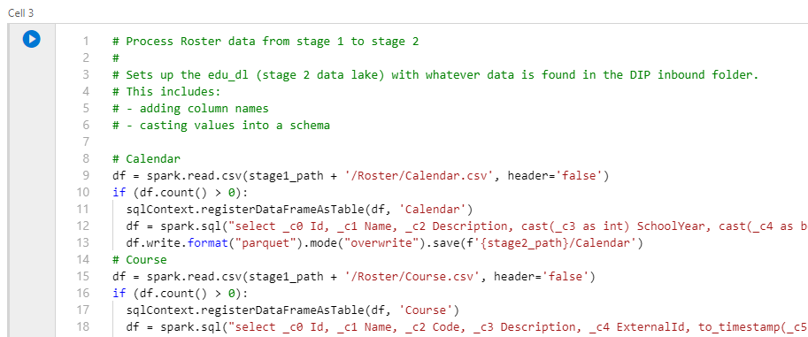
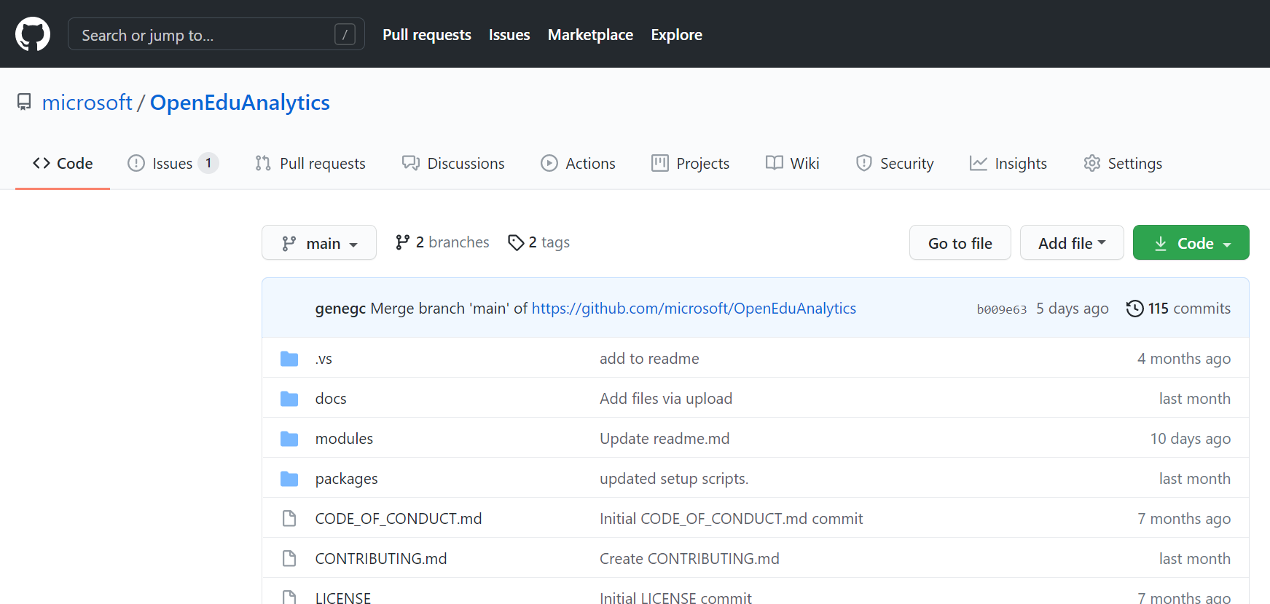
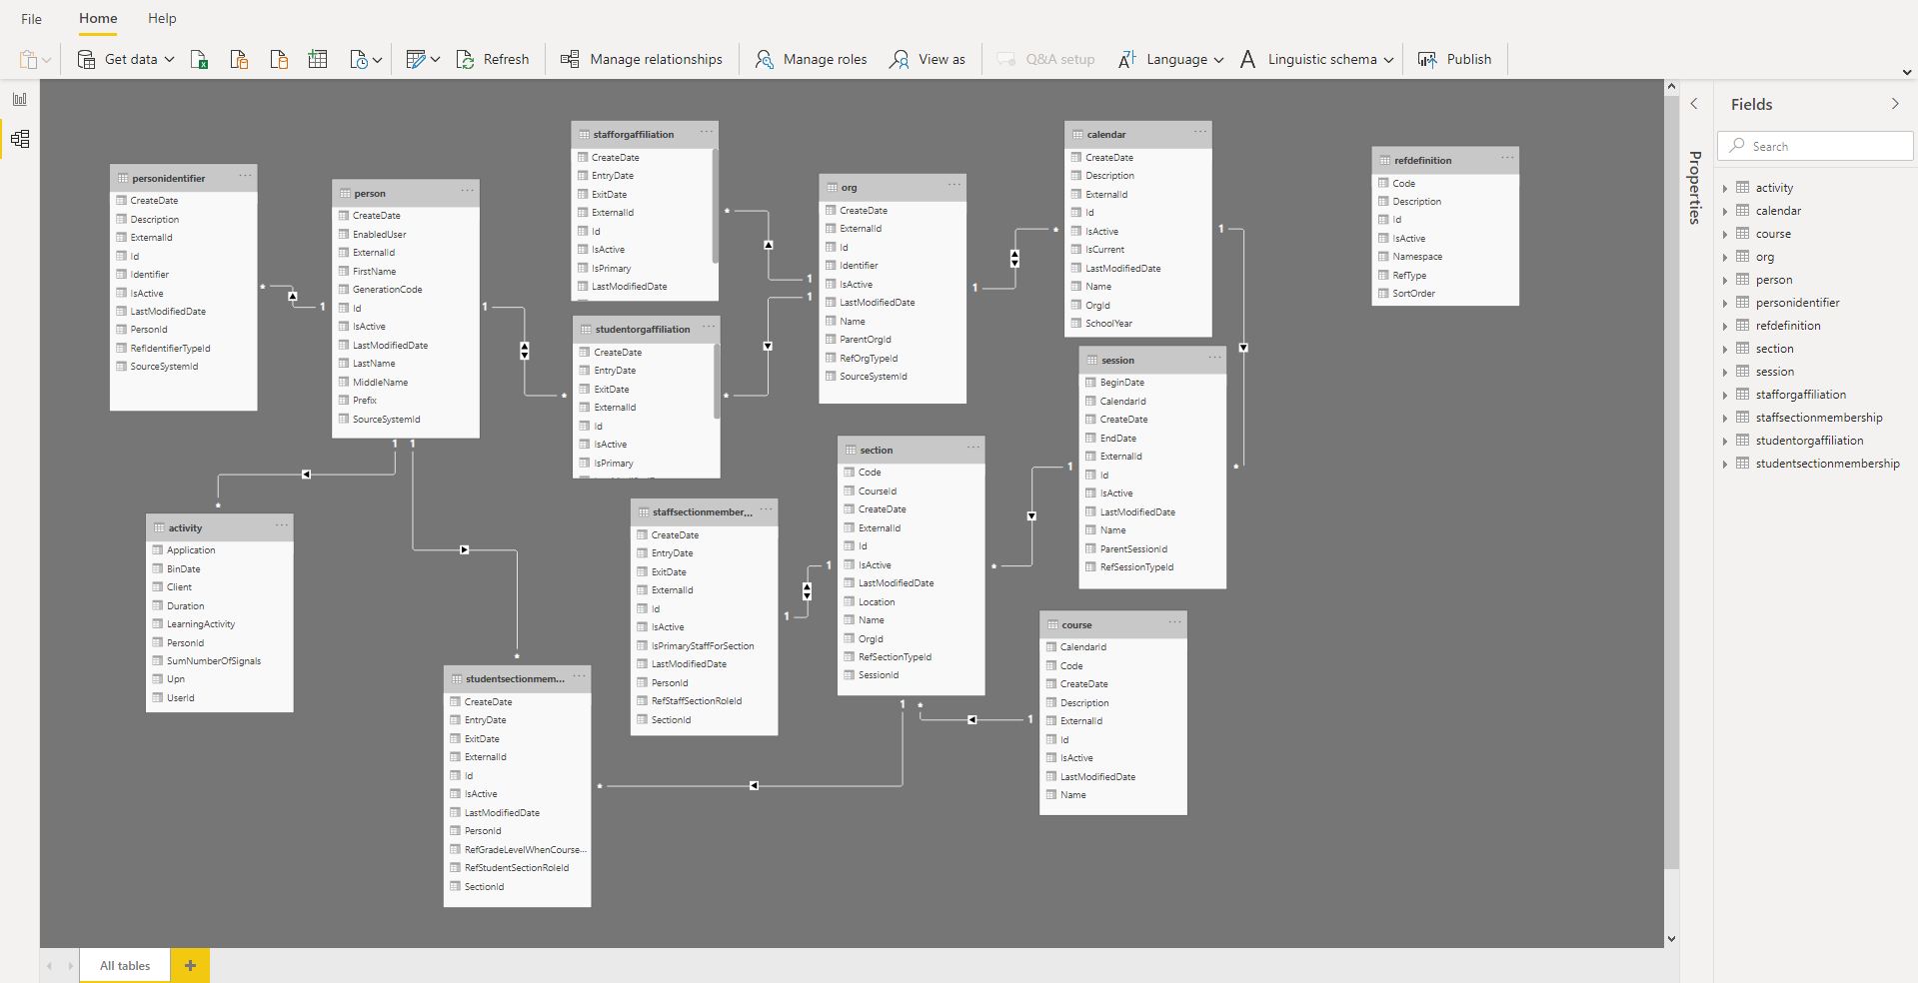
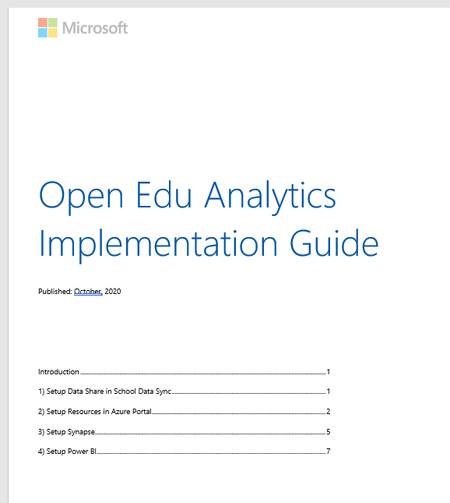
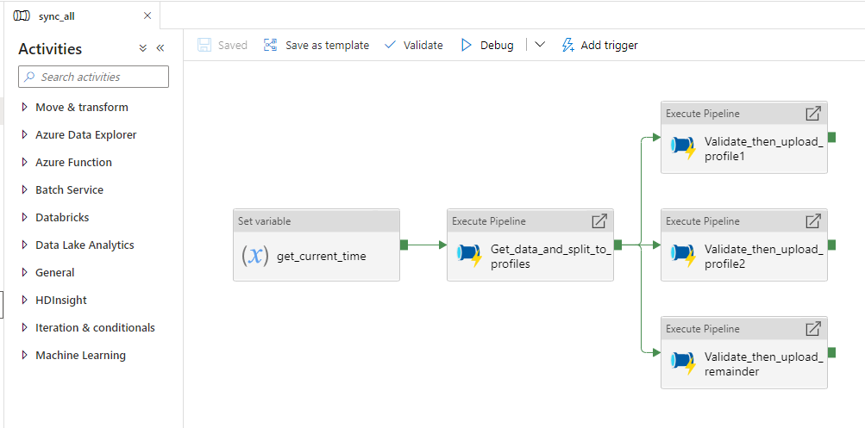
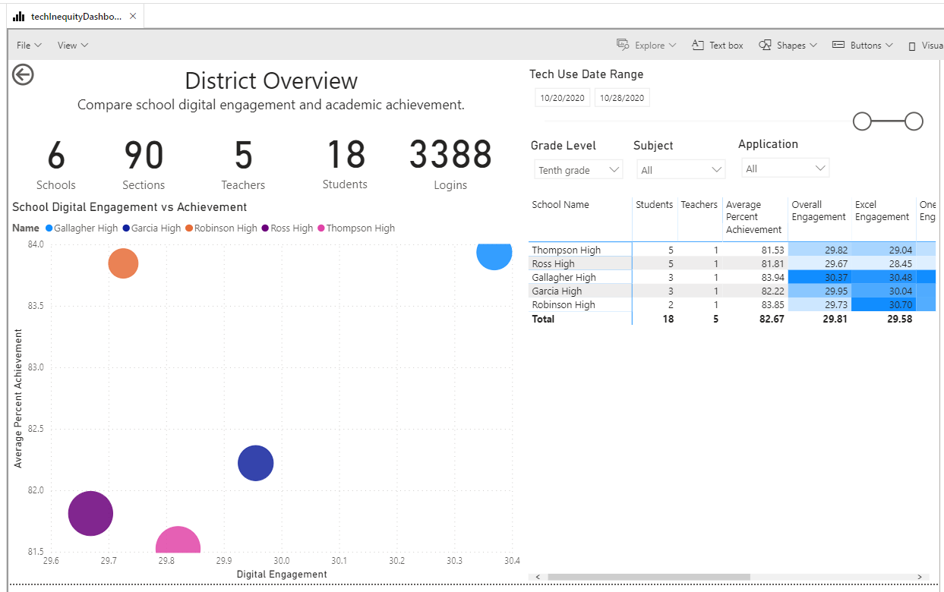

Slide 8
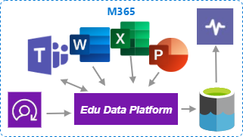



Data
Engineers
Data
Scientists
Contracted
Data Scientists
Learners,
Educators
School Leaders,
Researchers
Analysts
M365
Ingest
Prepare
Transform
& Enrich
Anonymize
Build
& Train
Explore
Visualize
Package
& Deliver
Dynamics / Power Apps
stage 1
stage 2
stage 3
data subsets
dedicated SQL pool
1) Collect
2) Compute
3) Communicate

Slide 9
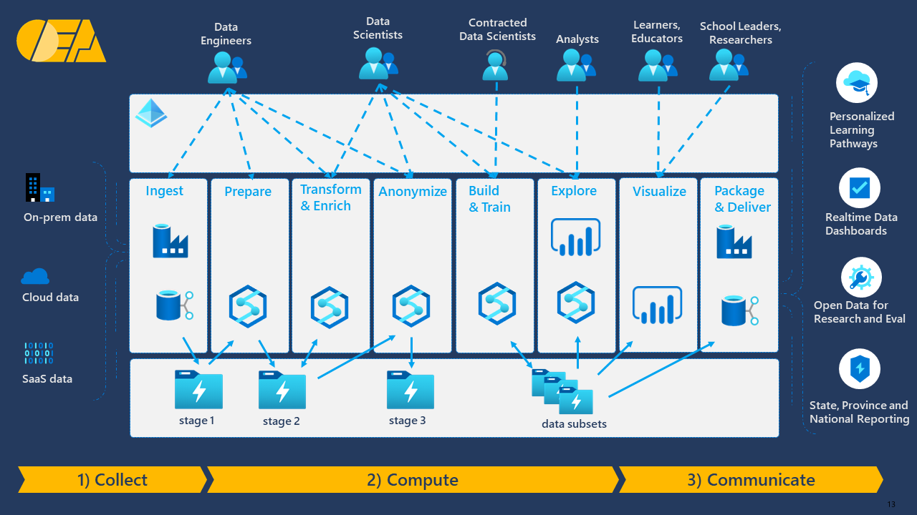
Multi-tenant architecture
Azure Active Directory
ADLS gen2
Azure Active Directory
ADLS gen2

Slide 10
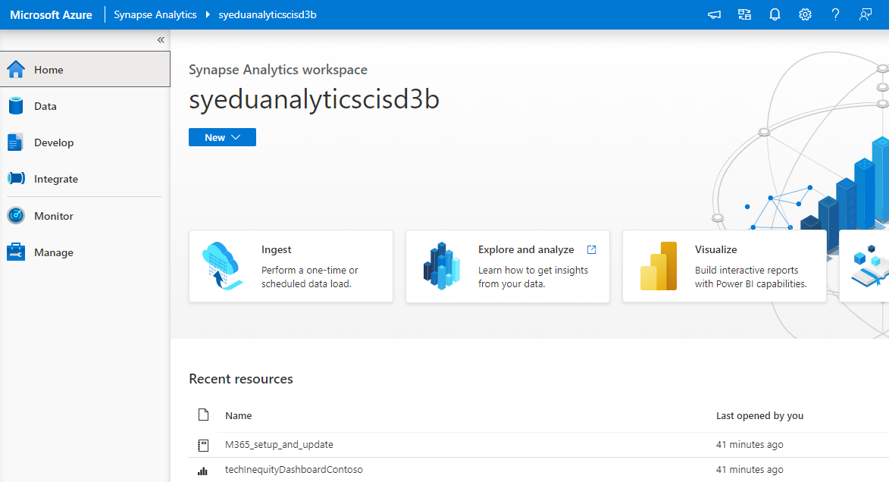
Demo

